Slide 1


Transcranial dirct current stimulation (tdcs)
HUMAN AND ARTIFICIAL MINDS AND BODIES
HUMANISE CORE FACILITY
Humanise Workshop:
Transcranial direct current stimulation
(tdcs)

Slide 2
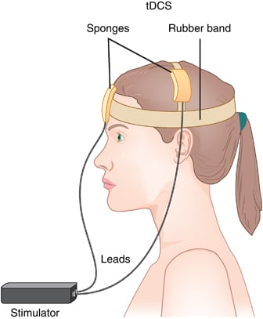
Transcranial direct current stimulation (tdcs)
What is it?
What is it?
Non-invasive brain stimulation technique used in psychology, neuroscience and clinical research
Weak direct current over the surface of the scalp via electrodes
Modulates cortical excitability and can influence brain function
Can be used in research on cognition, behaviour, neurorehabilitation

Slide 3
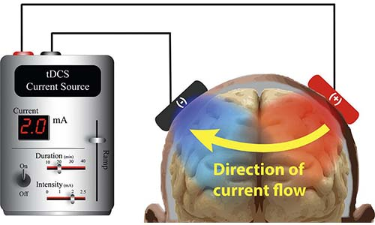
Transcranial direct current stimulation (tdcs)
How does it work?
How does it work?
Delivers weak direct current (typically 1-2 mA) through electrodes placed on the scalp
The electrical current flows from a positive electrode (anode) to a negative electrode (cathode)

Slide 4
Transcranial direct current stimulation (tdcs)
Mechanism of action
Mechanism of action
tDCS is believed to modulate neuronal membrane potentials → neuronal excitability
Effects depend on stimulation parameters, electrode placement, brain state etc.

Slide 5
Transcranial direct current stimulation (tdcs)
Anodal vs. cathodal tdcs
Anoval VS. Cathodal tDCS
ANODAL
Anode (positive electrode) is placed over the target brain region
Typically associated with increased cortical excitability
Neurons are more likely to fire
CATHODAL
Cathode (negative electrode) is placed over the target brain region
Typically associated with decreased cortical excitability
Neurons less likely to fire

Slide 6
Transcranial direct current stimulation (tdcs)
Advantages and disadvantages
Asvantages and disadvantages
Advantages
Non-invasive (safe)
Inexpensive
Portable and easy to use
Can be combined with behavioural tasks or trainings
Can be combined with imaging techniques (fMRI, EEG)
Applications in cognitive enhancement and neurorehabilitation
Disadvantages
Spatial resolution is relatively low (compared to other NIMBS techniques)
Current distribution in the brain is diffuse and difficult to control precisesly
High variability across participants
Results across studies are diverse/difficult to replicate between studies
60-70% of the current does not reach deeper structures

Slide 7
Transcranial direct current stimulation (tdcs)
Techni cal and practical considerations
Technical and practical considerations
Physiological factors that may affect tDCS results: skull thickness, cerebrospinal fluid (CSF), grey matter, white matter → different electrical conductivities
Cortical gyri and sulci affect how electric fields interact with neurons
Lateralization in different brain regions: e.g., the cortex = contralateral organization; cerebellum = ipsilateral organization
Duration? Typically 10-30 minutes
Timing? Concurrent stimulation (at the same time as the task) vs. Before the task? → depends on the nature of the task and your research question
Placement? → electrodes can be placed on the head (cephalic placement) or on the head an arm/upper body/chin

Slide 8
Transcranial direct current stimulation (tdcs)
Safety considerations
Informed consent
Participant monitoring at all times! Ramp-up + ramp-down of current are the most salient changes to the participant
Inclusion/exclusion criteria → NO metal implants in the head, history of epilepsy/seizures, damaged scalp at the site of electrodes
Poor contact = can increase risk of burns

Slide 9
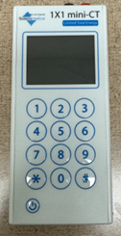
Transcranial direct current stimulation (tdcs)
How to generate codes

Slide 10
Transcranial direct current stimulation (tdcs)
How to generate codes step-by-step
PRESS POWER BUTTON
ENTER AN INTENSITY
PRESS ANY KEY TO CONTINUE
ENTER RAMP DURATION
PRESS 2 (ADMINISTRATION)
ENTER DURATION
ENTER PIN, THEN PRESS “#” (IF YOU WOULD LIKE TO USE THIS DEVICE, WE WILL PROVIDE PIN TO YOU)
PRESS “1”: ANODAL STIMULATION
PRESS “2”: SHAM STIMULATION
PRESS 1 (DC)
PRESS 3 (STIM PROFILES)
CHOOSE A TRANSPARENT PROFILE (= IS NOT IN USE)
ENTER THE NUMBER OF CODES YOU NEED

Slide 11
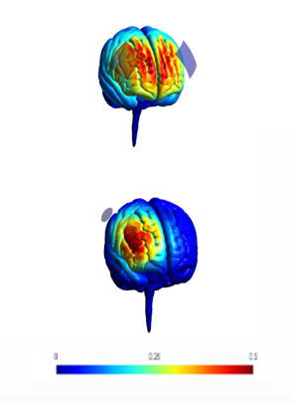
High-Definition Transcranial direct current stimulation
comparison field simulation of 4x1 HD vs bilateral
Example: Right-dlPFC

Slide 12


Our aim:
Facilitate research collaboration by providing access to labs and use of research equipment at the VUB for empirical research
Fee waiver
Users who do not have sufficient financial resources to pay the requested fees may request a fee waiver to use our facilities and equipment for a limited number of years
Condition: users will add this fee to their budget proposal(s) in their next grant proposal(s).

Slide 13
We warmly encourage you to get in contact with us for potential collaboration opportunities!
You can find us via
Our website: https://humanise.research.vub.be/en
Email: humanize@vub.be
Please check out our current offer for equipment and facilities here: https://humanise.research.vub.be/en/equipment

Slide 14
References and literature on tdcs methodology
Bastani, A., & Jaberzadeh, S. (2013). A-tDCS differential modulation of corticospinal excitability: The effects of electrode size. Brain Stimulation, 6(6), 932–937. https://doi.org/10.1016/J.BRS.2013.04.005
Bikson, M., Datta, A., & Elwassif, M. (2009). Establishing safety limits for transcranial direct current stimulation. Clinical Neurophysiology : Official Journal of the International Federation of Clinical Neurophysiology, 120(6), 1033. https://doi.org/10.1016/J.CLINPH.2009.03.018
Brunoni, A. R., Nitsche, M. A., Bolognini, N., Bikson, M., Wagner, T., Merabet, L., Edwards, D. J., Valero-Cabre, A., Rotenberg, A., Pascual-Leone, A., Ferrucci, R., Priori, A., Boggio, P. S., & Fregni, F. (2012). Clinical Research with Transcranial Direct Current Stimulation (tDCS): Challenges and Future Directions. Brain Stimulation, 5(3), 175. https://doi.org/10.1016/J.BRS.2011.03.002
Esmaeilpour, Z., Shereen, A. D., Ghobadi-Azbari, P., Datta, A., Woods, A. J., Ironside, M., O’Shea, J., Kirk, U., Bikson, M., & Ekhtiari, H. (2020). Methodology for tDCS integration with fMRI. Human Brain Mapping, 41(7), 1950–1967. https://doi.org/10.1002/HBM.24908
Ferrucci, R., Cortese, F., & Priori, A. (2015). Cerebellar tDCS: How to Do It. Cerebellum, 14(1), 27–30. https://doi.org/10.1007/s12311-014-0599-7
Grimaldi, G., Argyropoulos, G. P., Bastian, A., Cortes, M., Davis, N. J., Edwards, D. J., Ferrucci, R., Fregni, F., Galea, J. M., Hamada, M., Manto, M., Miall, R. C., Morales-Quezada, L., Pope, P. A., Priori, A., Rothwell, J., Tomlinson, S. P., & Celnik, P. (2016). Cerebellar Transcranial Direct Current Stimulation (ctDCS): A Novel Approach to Understanding Cerebellar Function in Health and Disease. Neuroscientist, 22(1), 83–97. https://doi.org/10.1177/1073858414559409
Krause, B., & Kadosh, R. C. (2014). Not all brains are created equal: The relevance of individual differences in responsiveness to transcranial electrical stimulation. In Frontiers in Systems Neuroscience (Vol. 8, p. 25). Frontiers. https://doi.org/10.3389/fnsys.2014.00025
Krause, B., Márquez-Ruiz, J., & Cohen Kadosh, R. (2013). The effect of transcranial direct current stimulation: a role for cortical excitation/inhibition balance? Frontiers in Human Neuroscience, 7(SEP). https://doi.org/10.3389/FNHUM.2013.00602
Li, L. M., Uehara, K., & Hanakawa, T. (2015). The contribution of interindividual factors to variability of response in transcranial direct current stimulation studies. Frontiers in Cellular Neuroscience, 9(MAY), 181. https://doi.org/10.3389/FNCEL.2015.00181/BIBTEX

Slide 15
References and literature on tdcs methodology
Nardo, D., Creasey, M., Negus, C., Pappa, K., Reid, A., Josephs, O., Callaghan, M. F., & Crinion, J. T. (2021). Transcranial direct current stimulation with functional magnetic resonance imaging: a detailed validation and operational guide. Wellcome Open Research, 6, 143. https://doi.org/10.12688/wellcomeopenres.16679.1
Nasseri, P., Nitsche, M. A., & Ekhtiari, H. (2015). A framework for categorizing electrode montages in transcranial direct current stimulation. Frontiers in Human Neuroscience, 9(FEB), 54. https://doi.org/10.3389/FNHUM.2015.00054/BIBTEX
Sadeghihassanabadi, F., Misselhorn, J., Gerloff, C., & Zittel, S. (2022). Optimizing the montage for cerebellar transcranial alternating current stimulation (tACS): a combined computational and experimental study. Journal of Neural Engineering, 19(2), 026060. https://doi.org/10.1088/1741-2552/AC676F
Stagg, C. J., & Nitsche, M. A. (2011). Physiological basis of transcranial direct current stimulation. In Neuroscientist (Vol. 17, Issue 1, pp. 37–53). https://doi.org/10.1177/1073858410386614
Thair, H., Holloway, A. L., Newport, R., & Smith, A. D. (2017). Transcranial direct current stimulation (tDCS): A Beginner’s guide for design and implementation. Frontiers in Neuroscience, 11(NOV), 1–13. https://doi.org/10.3389/fnins.2017.00641
van Dun, K., Bodranghien, F. C. A. A., Mariën, P., & Manto, M. U. (2016). TDCS of the cerebellum: Where do we stand in 2016? Technical issues and critical review of the literature. Frontiers in Human Neuroscience, 10(MAY2016), 199. https://doi.org/10.3389/FNHUM.2016.00199/BIBTEX
Woods, A. J., Antal, A., Bikson, M., Boggio, P. S., Brunoni, A. R., Celnik, P., Cohen, L. G., Fregni, F., Herrmann, C. S., Kappenman, E. S., Knotkova, H., Liebetanz, D., Miniussi, C., Miranda, P. C., Paulus, W., Priori, A., Reato, D., Stagg, C., Wenderoth, N., & Nitsche, M. A. (2016). A technical guide to tDCS, and related non-invasive brain stimulation tools. Clinical Neurophysiology, 127(2), 1031–1048. https://doi.org/10.1016/J.CLINPH.2015.11.012
Wörsching, J., Padberg, F., Goerigk, S., Heinz, I., Bauer, C., Plewnia, C., Hasan, A., Ertl-Wagner, B., & Keeser, D. (2018). Testing assumptions on prefrontal transcranial direct current stimulation: Comparison of electrode montages using multimodal fMRI. Brain Stimulation, 11(5), 998–1007. https://doi.org/10.1016/j.brs.2018.05.001

